Slide 1
uDeploy/uRelease Capability

Slide 2
UrbanCode Deploy
IBM UrbanCode Deploy is a tool for automating application deployments through your environments. It is designed to facilitate rapid feedback and continuous delivery in agile development while providing the audit trails, versioning and approvals needed in production.
UrbanCode Deploy provides
Automated, consistent deployments and rollbacks of applications
Orchestration of changes across servers, tiers and components
Configuration and security differences across environments
Clear visibility: what is deployed where and who changed what
Integrated with middleware, provisioning and service virtualization

Slide 3
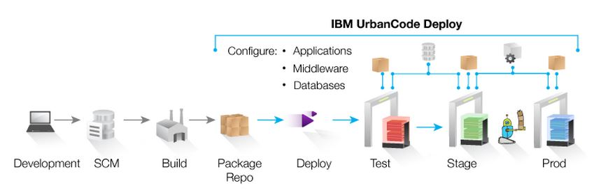
Typical Uses:
Continuous Delivery: Integrate with build and test tools to automatically deploy, test and promote new builds
Production Deployments: Orchestrate a complex production deployments of applications and configuration
Self-Service: Grant different teams rights to “push the go button” for different applications and environments
Incremental Updates: Deploy only the changes components or missing incremental (patch) versions

Slide 4
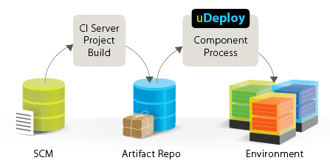
Key Expectations from uDeploy:
Multi-Platform Application Deployment Automation
Manage configurations across all environments
Offer secure ‘self-service’ capabilities
Increase transparency
Ensure governance and compliancy
IBM UrbanCode Deploy Server
- Rest-based services for Web UI and CLI client
- Manage Application, Component, Process, Resource, Security, Environment etc.
- Workflow engine for Application and Component process
Component: deployable artifacts with versions
Application:
- Components need to be deployed together (Snapshot)
- Environments which components will be deployed on
Process: series of steps operate on artifacts
Agent/Resource: Lightweigh process runs on target host
Enabling clients to more rapidly deliver mobile, cloud, big data and traditional applications with high quality and low risk.

Slide 5
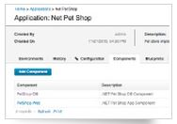
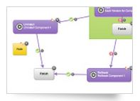
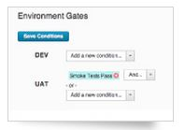

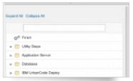
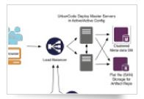
Key Features:
Multi-Tier Application Models
Easy Process Designer
Quality Gates and Approvals
Integrations Replace Custom Scripting
Scalable Distributed Automation
Track What is Where: Inventory

Slide 6
UrbanCode Release
IBM UrbanCode Release, formerly called uRelease, is a collaborative release management tool that helps you handle the growing number and complexity of releases. We can plan, execute, and track a release through every stage of the delivery lifecycle..
UrbanCode Deploy Release
Collaborative, web based release day planning and execution
Insight into which projects in a release are on time
Clear visibility into which versions of each app are in each environment
Enforced quality gates governing advancement into environments
“An intelligent collaboration release management solution that replaces error-prone manual spreadsheets and streamlines release activities for application and infrastructure changes.”

Slide 7
Typical Uses:
Identify Release Dependencies: From initial planning through discovery in testing, easily identify and track release dependencies across applications and infrastructure.
Release Planning and Tracking: Map applications, changes, and initiatives to releases, and track the completion of Application changes and attainment of quality certifications for applications in a release.
Easier Release Days: Build an executable deployment plan that seamlessly notifies team members of work to do, and triggers automated tasks while providing up-to-date status that everyone can see.
Handle More Releases: Accommodate a growing number of release using more templates, automatic rules, and visibility that mitigates risk.
Multi-Application Continuous Delivery: Rules for automatic promotion across groups of applications enables applications to take advantage of continuous delivery techniques.

Slide 8
Urban Code Release - Highlights
Planning
Prepare Releases for Development
Schedule releases
Release content impacting multiple applications
Project and release kickoff
Include: Dev, Vendors, COTs & infrastructure
Tracking
Focus release effort appropriately for
successful delivery
Development & test efforts are on-track
Dependencies & impacts of changes
are accounted for
Risks monitored and mitigated
Release-day planning
Governance
Rapidly move changes through
pipeline w/o destabilizing envs
Deployments controlled via quality
gates & approvals
Detailed deployment plans
Audit trail
Automation
Guarantee deploys are identical across
envs & reproducible
Push-button, standard processes
All deployment artifacts versioned
Inventory of artifacts deployed to each
environment

Slide 9
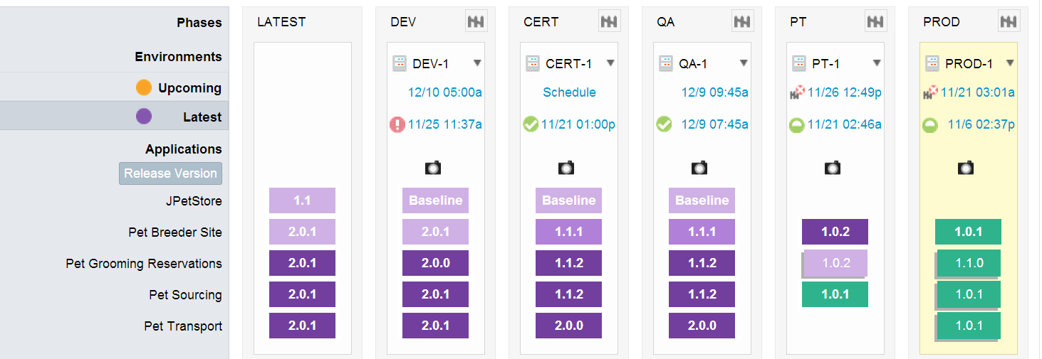
Key Features of Urbon Code Release
Increased Visibility and Control - Pipeline View
Keep track of the inventory across the entire life cycle of the release
Control the entire release lifecycle in an easy to use view

Slide 10
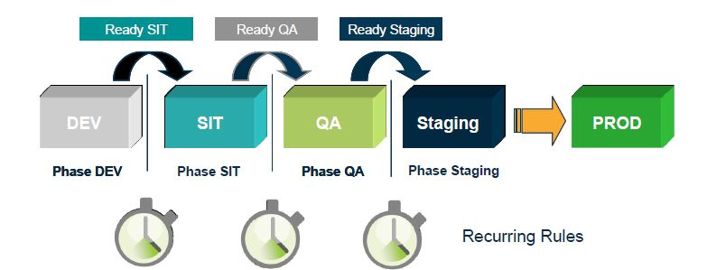
Boost your Release Process with Auto Progression
Recurring scheduled deployments
Fully automated deployments
Quality status enforced by the gates

Slide 11
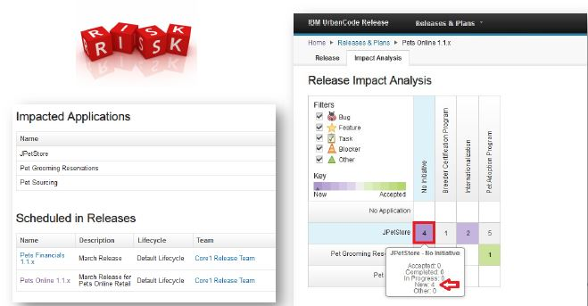
Risk Management – Impact Analysis
Track your changes and dependencies in the context of a release
Detect what application is at risk
Integrate with Rational Team Concert

Slide 12
IBM Urban Code Release New Feature (v6.1):
Push button deployments to the mainframe
Secure and reliable deployment and promotion of incremental native file system changes across
environments
Greater visibility of “what is where” with the ability rollback to any prior version at ease

